Slide 1
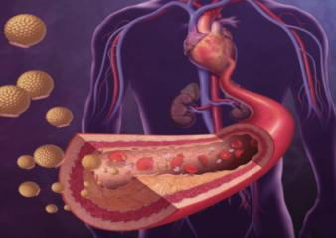
HIPERTRIGLICERIDEMIA ¿CÓMO Y CUÁNDO TRATARLA?
Clara Lucía Escorcia
Residente Medicina Interna - UPB

Slide 2
¿POR QUÉ HABLAR DE ESTE TEMA?
Enfermedad cardiovascular: principal causa de muerte.
Hipertrigliceridemia e hipercolesterolemia son factores modificables.
Estudio INTERHEART: DLP principal factor de riesgo para IAM.
Estudios epidemiológicos, ensayos clínicos: causalidad con LDL y ateroesclerosis.
Triglicéridos y ateroesclerosis: controvertida.
Laufs, U., Parhofer, K. G., Ginsberg, H. N., & Hegele, R. A. (2020). Clinical review on triglycerides. European Heart Journal, 41(1), 99-109c.
Notes:
a ECDV es la principal causa de muerte en el mundo. La
hipercolesterolemia y la hipertrigliceridemia son factores
de riesgo modificables para la ECDV.

Slide 3
PREVALENCIA
>150mg/dl: 25%
>200mg/dl 11%
> 500mg/dl 1%
> 1000mg/dl < 1%
Laufs, U., Parhofer, K. G., Ginsberg, H. N., & Hegele, R. A. (2020). Clinical review on triglycerides. European Heart Journal, 41(1), 99-109c.

Slide 4
FISIOPATOLOGÍA
Michos, E. D., McEvoy, J. W., & Blumenthal, R. S. (2019). Lipid management for the prevention of atherosclerotic cardiovascular disease. New England Journal of Medicine, 381(16), 1557-1567.
Notes:
Cuando ingerimos en la dieta los tg ESTOS SON absorbidos en el intestino y son trapostados por unos lipoporteinas hidrosolubles.
La lipoptorein lipasa degrada los qm, , pierden tg y ganan colesterol. HATA convertirse en LDL.
Y también pueden llegar al hiado
Los remanente de QM o de VLDL al endoteli o, despues a la intima y aquí interaccionan con los macrofagos.
Donde generan inflamacion, reclutamiento de monocitos, activacion plaqeutaria y disfuncion endotelai.
Eventos necesarios para que se produzcan placa ateroesclerotica.
Metabolismo de los tg
Cuando lo ingerimos en la dieta es trasnportada hasta la sangre por una lipoproteinas hidrosulubles,
La primera son los del intestino a los linftivcos
Por la LPL degrdan los QM la parte de TG hacia acidos grasos, estos TG se ponene mas pequeños, pierden tg y ganan colesterol. HATA convertirse en LDL.
Llega al higado.
Apo B : lipoproterina mas relacionada con la aterogenesis
LOS remantes llegan al endoteli o, despues a la intima y aquí interaccionan con los macrofagos.
Los tG no necesitan ser oxidados para interactuar con el macrofago, comparado con los LDL que si necesitan ser oxidados.
Aquí los remantes generan inflamacion, reclutamiento de monocitos, activacion plaqeutaria y disfuncion endotelai.
Eventos necesariospara que se produzcan placa ateroesclerotica.
FISIOPATOLOGIA
Dietary triglycer- ides are assembled in the gut into chylomicrons. Their interaction with lipoprotein lipase (LpL) located on the luminal surface of capillary endothelial cells leads to lib- eration of free fatty acids from triglyceride; free fatty acids are able to traverse cell membranes.
Only 50% of chylo- micron triglyceride is estimated to be lost in this process, and the remainder of the lipoprotein, called a chylomicron remnant, contains lipids such as cholesteryl esters, retinyl esters, and apoB-48
Several proteins, called apolipopro- teins (apo), regulate LpL actions and lipoprotein clearance from the liver. apoC-II is the necessary cofactor for LpL actions. apoC-III blocks the uptake of lipoproteins by re- ceptors in the liver and may impair LpL
apoE is the ligand for hepatic uptake of triglyceride-rich remnants.
VLDL particles are produced by the liver, and the VLDL triglyc- eride content is derived from a variety of substrates in- cluding lipoprotein triglyceride, free fatty acids, and de novo fatty acids synthesized from carbohydrates. VLDL triglycerides lose free fatty acids by the action of LpL, leading to production of VLDL remnants, also referred to as intermediate-density lipoproteins (IDL), and eventually to conversion to LDL.

Slide 5
CAUSAS SECUNDARIAS
Causa
Aumento de ingesta de carbohidratos | Fructosa > glucosa.
Ingesta de alcohol
Diabetes Mellitus tipo 2 | No controlada. Obesidad central, resistencia a la insulina.
Estrógenos (embarazo, reemplazo oral, tamoxifeno) | Secrecion hepatica VLDL.
Hipotiroidismo | Aumento de LDL, TG.
Antihipertensivos | B bloqueadores.
Diureticos | Tiazidas, furosemida
Antirretrovirales | Inhibidores de proteasa ( ritonavir, lopenavir)
Segunda generación antisicoticos | NO en aripriprazol ni ziprasidona
Laufs, U., Parhofer, K. G., Ginsberg, H. N., & Hegele, R. A. (2020). Clinical review on triglycerides. European Heart Journal, 41(1), 99-109c.
Notes:
Cuando encmtramo trigiliceridos elevados
CAUSAS SECUNDARIAS
We recommend that individuals found to have any elevation of fasting triglycerides should be evaluated for secondary causes of hyperlipidemia including endocrine conditions and medications. Treatment should be focused on such secondary causes
TRASTORNOS ENDOCRINOS
Patients with untreated diabetes mellitus and insulin deficiency commonly have hypertriglyceridemia; this con- dition occurs more frequently in type 2 than in type 1 diabetes mellitus. Appropriate diabetes management re- duces triglyceride levels. Mild hypertriglyceridemia, typ- ically seen in treated type 2 diabetes, is probably related to the presence of central obesity and insulin resistance (83).
Hypertriglyceridemia related to increased insulin resis- tance and to decreased activity of both hepatic lipase and LpL occurs in some acromegalic patients (84).
Owing to estrogen-induced stimulation of the secretion of hepatic triglyceride-rich lipoprotein, triglyceride levels increase progressively during pregnancy, with levels in the third trimester increased by 200% or more over levels before pregnancy. In women with underlying disorders of triglyceride metabolism or overproduction, an estrogen- induced increase in triglycerides during pregnancy can re- sult in a risk of pancreatitis with potential fetal loss (85, 86). Oral estrogen in the form of estrogen replacement therapy or oral contraceptives has a triglyceride-increas- ing effect due to increased hepatic VLDL production. This effect does not occur with transdermal estrogen due to its lesser exposure to the liver (87, 88). Tamoxifen, a selective estrogen receptor modulator, can also increase triglycer- ide levels. The effect is less pronounced with raloxifene, but that drug can increase levels in women with an un- derlying propensity to hypertriglyceridemia (89, 90).
Thyroid hormone deficiency is associated with in- creased LDL cholesterol levels; this increase has been pos- tulated to be due to decreased function of LDL receptors. There can also be an increase in triglyceride levels. Hypo hyroidism can lead to the expression of dysbetalipopro- teinemia (91–93).
Glucocorticoids have several effects on lipoprotein me- tabolism including increased cholesterol production from induction of hydroxymethylglutaryl coenzyme A reduc- tase, increased fatty acid synthesis due to increased ex- pression of fatty acid synthase, and decreased clearance of triglyceride-rich lipoproteins (94). Because weight gain and insulin resistance are major effects of both exogenous and endogenous glucocorticoid excess, elevated triglycer- ides can be seen in Cushing’s syndrome as well as during glucocorticoid treatment.
Many drugs raise triglyceride levels. One of the most com- monly used is alcohol. Alcohol intake increases hepatic fatty acid synthesis and decreases fatty acid oxidation, with a net effect to stimulate hepatic VLDL triglyceride secretion. The effects of alcohol vary interindividually, tend to be amplified in subjects with underlying lipid disorders, are dose-depen- dent (106), and may be related to the mode of intake (107).
Antihypertensive drugs with a potential to increase tri- glyceride levels are thiazide (and furosemide) diuretics and 􏰅-adrenergic blocking agents. The hypertriglyceridemic effect of 􏰅-adrenergic blocking agents is greater for atenolol, metoprolol, and propranolol than for carvedilol. These effects are most relevant in patients with underlying genetic hypertriglyceridemia (94).
Oral estrogens increase the hepatic secretion of VLDL, leading in turn to an increase in serum triglyceride levels (108). In patients with familial hypertriglyceridemia or LpL deficiency, the use of oral estrogens can provoke se- vere pancreatitis (109). An increase in hepatic VLDL and apoC-III production and perhaps a decrease in LpL lead- ing to increased triglyceride levels are also seen during use of retinoids such as isotretinoin and the anticancer drug bexarotene (110–112).
Bile acid sequestrants (cholestyramine, colestipol, colesevelam) can worsen hypertriglyceridemia and are contraindicated in patients with severe hypertriglycer- idemia (􏰀1000 mg/dl) and in patients with dysbetali- poproteinemia. Patients with normal baseline triglyc- eride levels experience minimal triglyceride increases with bile acid sequestrant therapy, but those with mod- erate hypertriglyceridemia (triglycerides 􏰀 200 mg/dl) may experience substantial further elevation (113).
Dyslipidemia is a frequent complication of antiretro- viral therapy for HIV infection. In particular, the protease inhibitors ritonavir and lopinavir can increase plasma tri- glyceride levels (114).
Immunosuppressants such as sirolimus also increase triglyceride levels (115).
Certain second-generation antipsychotic medications such as clozapine, olanzepine, risperidone, and quetiapine can be associated with hypertriglyceridemia, but this effect has not been seen for aripiprazol or ziprasidone. Those that are associated with weight gain, insulin resistance, and worsening of the metabolic syndrome are particularly important contributors to secondary hyperlipidemia. Among selective serotonin reuptake inhibitors, sertraline may raise triglycerides (116).

Slide 6
CAUSAS PRIMARIAS
HTG moderada: efecto poligenético (VLDL producción y eliminación).
HTG severa: efecto monogenético: 6 genes: LPL, apo C2, apoA5, LMF1, FPIHBP1, GPD1.
Efecto monogenético: Síndrome de quilomicronemia familiar.
Efecto monogénico: interferencia en la eliminación de los quilomicrones.
Laufs, U., Parhofer, K. G., Ginsberg, H. N., & Hegele, R. A. (2020). Clinical review on triglycerides. European Heart Journal, 41(1), 99-109c.
Notes:
severe HTG has both
. monogenic and polygenic determinants. A tiny subset of these . patients (perhaps 2%) has monogenic chylomicronaemia or familial . chylomicronaemia syndrome (FCS, former Type 1), a rare form of . monogenic HTG with estimated prevalence of 1–10 in a million.
CAUSAS:
PRIMARIAS Y SECUNDARIAS
We recommend that individuals found to have any elevation of fasting triglycerides should be evaluated for secondary causes of hyperlipidemia including endocrine conditions and medications. Treatment should be focused on such secondary causes (1/QQEE).
2.2. We recommend that patients with primary hy- pertriglyceridemia be assessed for other cardiovascular risk factors, such as central obesity, hypertension, ab- normalities of glucose metabolism, and liver dysfunc- tion (1/QQEE).
2.3. We recommend that clinicians evaluate patients with primary hypertriglyceridemia for family history of dyslipidemia and cardiovascular disease to assess genetic causes and future cardiovascular risk

Slide 7
¿EN QUIÉN SOSPECHAR UNA HIPERTRIGLICERIDEMIA FAMILIAR?
Familiar de primer grado con enfermedad coronaria prematura conocida (H < 55, M < 60).
Colesterol total > 290mg/dl (< 30 años), > 350mg/dl (> 30 años).
ECV o enfermedad vascular (H < 55, M < 60).
Xantoma tendinoso.
Arco corneal < 65 años.
Notes:
Suspect familial hypercholesterolaemia (FH) as a possible diagnosis in adults
with:
• a total cholesterol level greater than 7.5 mmol/l or
• a personal or family history of premature coronary heart disease (an event before
60 years in an index individual or first-degree relative).
younger than 30 years, with a total cholesterol concentration greater than 7.5 mmol/l
and
• 30 years or older, with a total cholesterol concentration greater than 9.0 mmol/l
as these are the people who are at highest risk of FH.
Healthcare professionals should exclude secondary causes of
hypercholesterolaemia before a diagnosis of FH is considered.

Slide 8
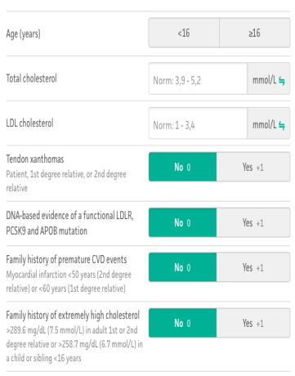
Criterios Simon Broome
Notes:
Refer the person to an FH specialist service for DNA testing if they meet the
Simon Broome criteria for possible or definite FH, or they have a DLCN score
greater than 5.

Slide 9
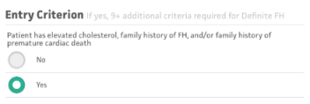
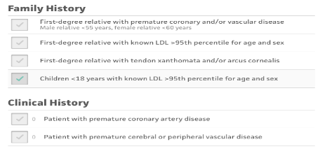
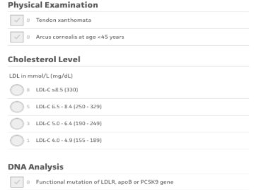
Criterios DLCN
Notes:
Refer the person to an FH specialist service for DNA testing if they meet the
Simon Broome criteria for possible or definite FH, or they have a DLCN score
greater than 5.

Slide 10
¿RIESGO CARDIOVASCULAR?
Notes:
Es claro y ya esta ampliamente estudiado el reisgo caridvascular de los LDL con los eventos caridovascualres pero que pasa cuando nos preguntamos con los TG

Slide 11
Epidemiológico
Dos estudios prospectivos:
Estudio Reykjavik.
EPIC.
44237 pacientes, 3582 casos.
12 estudios: 3785 casos.
Objetivo: identificar la asociación de los TG y los eventos cardiovasculares .
Sarwar, N., Danesh, J., Eiriksdottir, G., Sigurdsson, G., Wareham, N., & Bingham, S. (2006). Triglycerides and the risk of coronary heart disease: 10,158 incident cases among 262,525 participants in 29 Western prospective studies. Circulation [Internet]. 2007 Jan 30 [cited 2019 Feb]; 115 (4): 450–8.
Notes:
Muchos estudios epidemologicos se han realizado para evaluar la asocaicon de ls tg con la enfermdad coronaria sn esmbargo no ha sdo realmente cuantificado
La asociedad americana de cardiologia hizo este estuduo epidemiologico
Many epidemiological studies have reported on associations between serum triglyceride concentrations and the risk of coronary heart disease, but this association has not been reliably quantified.
La asociedad americana de cardiologia hizo este estuduo epidemiologico
we report primary data on triglyceride concentrations from 2 prospective cohort studies: the Reykjavik study and the European Prospective Investigation of Cancer (EPIC)-Norfolk study, which together comprise 44 237 Western middle-aged men and women of predominantly white European continental ancestry and a total of 3582 incident cases of CHD (including 1089 female cases), more CHD cases than reported in either previous meta- analysis.
adding 12 more studies (involving an additional 3785 CHD cases)
on the potential etiological association of circulating triglycerides with CHD risk;
ABSTRACT: Background— Many epidemiological studies have reported on associations between serum triglyceride concentrations and the risk of coronary heart disease, but this association has not been reliably quantified.
we report 2 separate nested case-control comparisons in 2 different prospective, population-based cohorts, plus an updated meta-analysis of 27 additional prospective studies in general Western populations.
Measurements were made in a total of 3582 incident cases of fatal and nonfatal coronary heart disease and 6175 controls selected from among the 44 237 men and women screened in the Reykjavik and the European Prospective Investigation of Cancer (EPIC)-Norfolk studies. Repeat measurements were obtained an average of 4 years apart in 1933 participants in the EPIC-Norfolk Study and an average of 12 years apart in 379 participants in the Reykjavik study. The long-term stability of log-triglyceride values (within-person correlation coefficients of 0.64 [95% CI, 0.60 to 0.68] over 4 years and 0.63 [95% CI, 0.57 to 0.70] over 12 years) was similar to those of blood pressure and total serum cholesterol
Similar overall findings (adjusted odds ratio, 1.72; 95% CI, 1.56 to 1.90) were observed in an updated meta-analysis involving a total of 10 158 incident coronary heart disease cases from 262 525 participants in 29 studies.Conclusions— Available prospective studies in Western populations consistently indicate moderate and highly significant associations between triglyceride values and coronary heart disease risk. Because these associations depend considerably on levels of established risk factors, however, further studies are needed to help assess the nature of any independent

Slide 12
 | Estudio Reykjavik | Epic Norfolk study
Ajustado: Edad, sexo | OR: 2.04 ( 1.78 – 2.32) | OR: 1.95 ( 1.63 – 2.33)
Fumador, Glucosa en ayunas, DM, colesterol total , HDL, LDL | OR: 1.43 ( 1.23 – 1.65) | OR: 1.52 ( 1.24 – 1.89)
Sarwar, N., Danesh, J., Eiriksdottir, G., Sigurdsson, G., Wareham, N., & Bingham, S. (2006). Triglycerides and the risk of coronary heart disease: 10,158 incident cases among 262,525 participants in 29 Western prospective studies. Circulation [Internet]. 2007 Jan 30 [cited 2019 Feb]; 115 (4): 450–8.
Notes:
In the Reykjavik study, the odds ratio for CHD adjusted for age, gender, and calendar period was 2.04 (95% CI, 1.78 to 2.32; Wald test statistic, χ12=106) in individuals in the top third compared with those in the bottom third of baseline log-triglyceride concentrations (corresponding to tertile cutoffs of 1.28 and 0.87 mmol/L). The odds ratio fell to 1.43 (95% CI, 1.23 to 1.65; χ12=21) after further adjustment for smoking and several other established coronary risk factors, including fasting glucose and total serum cholesterol concentration
n the EPIC-Norfolk study, the odds ratio
https://www.ahajournals.org/reader/content/10.1161/CIRCULATIONAHA.106.637793/format/epub/EPUB/xhtml/index.xhtml Página 12 de 27
e
p c
Triglycerides and the Risk of Coronary Heart Disease 13/09/20, 12)18 a. m.
for CHD adjusted for age, gender, and calendar period was 1.95 (95% CI, 1.63 to 2.33; Wald test statistic, χ12=52.7) in individuals in the top third compared with those in the bottom third of baseline log-triglyceride concentrations (corresponding to tertile cutoffs of 2.00 and 1.33 mmol/L). The odds ratio fell to 1.52 (95% CI, 1.24 to 1.89; χ12=15.0) after further adjustment for smoking and several other established coronary risk factors, including low-density lipoprotein cholesterol, and fell still further to 1.31 (95% CI, 1.06 to 1.62; χ12=5.1) after additional adjustment for HDL cholesterol (Table 3).

Slide 13
Aumento de TG aumenta el riesgo de enfermedad coronaria → ajustarlo, especialmente HDL, disminuye la magnitud de la asociación.
OR combinado ajustado: 1.7 (1.6 – 1-9).
Riesgo fue igual en mujeres y hombres.
No hubo diferencias en la asociación de TG con enfermedad coronaria en estudios con muestras en ayunas comparado con postprandiales.
Asociación débil TG con enfermedad coronaria en EUA y Europa → secundaria al tamaño de la muestras de los estudios.
Sarwar, N., Danesh, J., Eiriksdottir, G., Sigurdsson, G., Wareham, N., & Bingham, S. (2006). Triglycerides and the risk of coronary heart disease: 10,158 incident cases among 262,525 participants in 29 Western prospective studies. Circulation [Internet]. 2007 Jan 30 [cited 2019 Feb]; 115 (4): 450–8.
Notes:
Second, although there is consistent evidence that raised circulating triglyceride levels are associated with increased CHD risk, adjustment for established coronary risk factors, especially HDL cholesterol, substantially attenuated the magnitude of this association (evident by the sharp decline in the χ2 on adjustment of risk estimates for such factors in both the Reykjavik and EPIC-Norfolk Studies). Third, the combined odds ratio for CHD in Western populations, adjusted for several established risk factors, was ≈1.7 (95% CI, 1.6 to 1.9) in individuals with usual triglyceride values in the top third of the population compared with those in the bottom third, which is very similar to the combined odds ratio previously reported in Asian and Pacific populations.30 Fourth, the available data indicate that the impact of triglycerides on CHD risk is similar in men and women. This finding contrasts with previous suggestions that the hazard
is substantially greater in women,29 and this issue requires further investigation in more detailed analyses (described below). Also, in contrast to previous suggestions based on much sparser data,38 the present data suggest no important differences in the strength of associations between triglycerides and CHD in studies of fasting participants compared with studies of nonfasting participants. Finally, the present data suggest that the somewhat weaker association noted between triglycerides and CHD risk in North American than in European populations is probably accounted for largely by differences in study sample size, but this may require further investigation.
*Cut points for top and bottom thirds of log-triglyceride levels were 0.25 and −0.14 (exponentiated to 1.28 and 0.87 mmol/L) in the Reykjavik study and 0.30 and 0.11 (exponentiated to 2.00 and 1.33 mmol/L) in the EPIC-Norfolk study, respectively.

Slide 14
Prospectivo.
26509 mujeres en EUA.
Seguimiento: 11.4 años.
Objetivo: determinar la asociacion entre niveles de TG y riesgo de eventos cardiovasculares.
Desenlace primario: compuesto (IM no faltal, ECV no fatal, revascularizacion coronaria y muerte por evento cardiovascular).
Bansal, S., Buring, J. E., Rifai, N., Mora, S., Sacks, F. M., & Ridker, P. M. (2007). Fasting compared with nonfasting triglycerides and risk of cardiovascular events in women. Jama, 298(3), 309-316.
Notes:
Prospective study of 26 509 initially healthy US women (20 118 fasting and 6391 nonfasting) participating in the Women’s Health Study, enrolled between November 1992 and July 1995 and undergoing follow-up for a median of 11.4 years. Triglyceride levels were measured in blood samples ob- tained at time of enrollment.
Objective Todeterminetheassociationoftriglyceridelevels(fastingvsnonfasting) and risk of future cardiovascular events.
Main Outcome Measure Hazard ratios for incident cardiovascular events (non- fatal myocardial infarction, nonfatal ischemic stroke, coronary revascularization, or car- diovascular death).

Slide 15
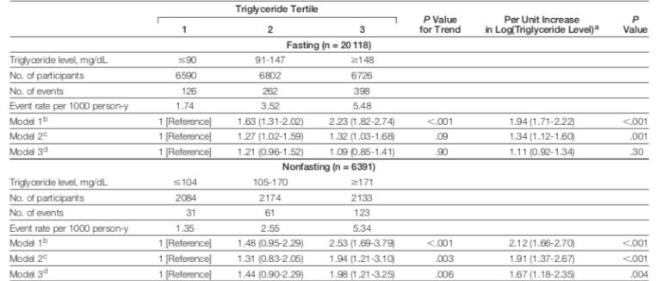
Bansal, S., Buring, J. E., Rifai, N., Mora, S., Sacks, F. M., & Ridker, P. M. (2007). Fasting compared with nonfasting triglycerides and risk of cardiovascular events in women. Jama, 298(3), 309-316.
Notes:
Aqui podemos ver los HR de repecto al aumento de los tg y los eventos cardiovasculares sin embargo qu enos llama la atencion de esta tabla
Que nos llama la atencion de esta tabla al ajustar los analisis
En el analisis univariables ajustado apra la edad, BP ambos en ayunas y postprandial tiene asocaicn, sin embargo en lospaccientes con mediciones en ayuno cuando se ajustaba poara colesterol ototal y HDL y en idnicacodres de resistencia a la isnuluna habia una reduccion de la asicacion, 1.21 y un Ci que pasaba la unidad y 1.09 tambeien pasaba la unidad
n univariable analyses of event rates and after adjusting for age, blood pressure, smoking, and use of hor- mone therapy (model 1), both fasting and nonfasting triglyceride levels were strongly associated with cardiovascu- lar events. Among fasting participants, adjusting for total cholesterol and HDL-C (model 2) and for indicators of insulin resistance (diabetes mellitus, body mass index, and high-sensitivity
C-reactive protein) (model 3) substan- tially reduced the association between fasting triglyceride levels and cardio- vascular events (fully adjusted HRs [95% CIs] for increasing tertiles of fasting triglyceride levels: 1 [refer- ence], 1.21 [0.96-1.52], and 1.09 [0.85-1.41] [P = .90 for trend]).
In con- trast, nonfasting levels maintained a strong association with cardiovascular events in fully adjusted models, with HRs (95% CIs) for increasing tertiles of nonfasting levels of 1 (reference), 1.44 (0.90-2.29), and 1.98 (1.21-3.25) (P = .006 for trend).

Slide 16
Notes:
Despus de encontrar este hallazgo donde hbia significancia estdistica en los tg posprandiales,
estartifico lso tiempos postprandiales s eevidenico una mayor asoacion cuanso se tomanban entre las 2. y4 horas despues,
analyses stratified by postpran- dial time, women who had eaten 2 to 4 hours prior to phlebotomy had the strongest association between triglyc- eride levels and cardiovascular events (P 􏰅 .001 for trend across tertiles) more attenuated as more time elapsed after the participants’ last meal.
(FIGURE 1).

Slide 17
CONCLUSIONES
Niveles más altos de TG postprandiales tuvieron una asociación fuerte con aumento de eventos cardiovasculares independiente de los factores de riesgo y marcadores de resistencia a la insulina.
Niveles en ayunas mostraron poca asociación con eventos cardiovasculares.
Notes:
Conclusiones
we ob- served that higher nonfasting triglyc- eride levels were strongly associated with an increased risk of future cardio- vascular events, independent of base- line cardiac risk factors, levels of other lipids, and markers of insulin resis- tance. In contrast, fasting triglyceride levels showed little independent asso- ciation with cardiovascular events. As- sociations were particularly strong among individuals who had their blood drawn 2 to 4 hours after a meal, and this relationship weakened as more time elapsed postprandially.
.

Slide 18
Schwartz, G. G., Abt, M., Bao, W., DeMicco, D., Kallend, D., Miller, M., ... & Olsson, A. G. (2015). Fasting triglycerides predict recurrent ischemic events in patients with acute coronary syndrome treated with statins. Journal of the American College of Cardiology, 65(21), 2267-2275.
Notes:
Queiran evidaneicar si los tg tomados en ayunas predecian la recurrencai de los evenos iaquemicao en oaceinre con SCA con esattinas
Triglyceride levels also independently predict long- and short-term ASCVD risk in patients post an acute coronary syndrome, who are treated with a statin and therefore represent a potential target in sec- ondary prevention.21
Fasting triglyceride levels were associated with both long-term and short-term risk after ACS en oaceintes en trararmiento con estatinas

Slide 19
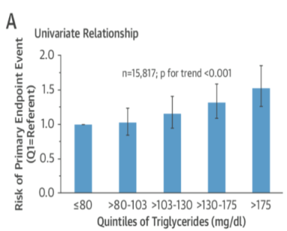
HR: 1.01 ( 1.01 – 1.02) P< 0-001
Schwartz, G. G., Abt, M., Bao, W., DeMicco, D., Kallend, D., Miller, M., ... & Olsson, A. G. (2015). Fasting triglycerides predict recurrent ischemic events in patients with acute coronary syndrome treated with statins. Journal of the American College of Cardiology, 65(21), 2267-2275.
Notes:
A largo plazo:
Adjustment for age, sex, hyperten- sion, current smoking, diabetes, HDL-C, and body mass index did not attenuate the relationship
In unadjusted analysis, a 10-mg/dl increment in triglycerides was associated with hazard ratio of 1.016 (95% confidence interval [CI]: 1.010 to 1.022; p < 0.001). Adjustment for age, sex, hyperten- sion, current smoking, diabetes, HDL-C, and body mass index did not attenuate the relationship (hazard ratio: 1.018; 95% CI: 1.011 to 1.024; p < 0.001). Risk in- creased monotonically across quintiles of triglyce- rides (p < 0.001 for trend) (Figure 1)
long-term risk increased across quintiles of baseline triglycerides (p < 0.001). The hazard ratio in the highest/lowest quintile (>175/#80 mg/dl) was 1.61 (95% confidence interval: 1.34 to 1.94).
short-term risk increased across tertiles of baseline triglycerides (p 1⁄4 0.03), with a hazard ratio of 1.51 (95% confidence interval: 1.05 to 2.15) in highest/lowest tertiles (>195/#135 mg/dl)
The relationship of triglycerides to risk was independent of low- density lipoprotein cholesterol in both studies.

Slide 20
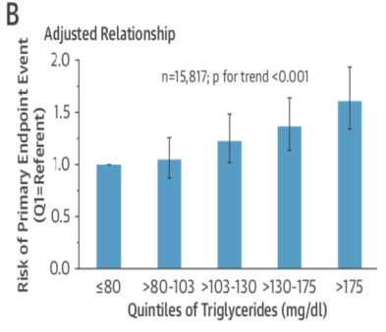
HR: 1.01 ( 1.01 – 1.02)
Schwartz, G. G., Abt, M., Bao, W., DeMicco, D., Kallend, D., Miller, M., ... & Olsson, A. G. (2015). Fasting triglycerides predict recurrent ischemic events in patients with acute coronary syndrome treated with statins. Journal of the American College of Cardiology, 65(21), 2267-2275.
Notes:
A largo plazo:
Adjustment for age, sex, hyperten- sion, current smoking, diabetes, HDL-C, and body mass index did not attenuate the relationship
In unadjusted analysis, a 10-mg/dl increment in triglycerides was associated with hazard ratio of 1.016 (95% confidence interval [CI]: 1.010 to 1.022; p < 0.001). Adjustment for age, sex, hyperten- sion, current smoking, diabetes, HDL-C, and body mass index did not attenuate the relationship (hazard ratio: 1.018; 95% CI: 1.011 to 1.024; p < 0.001). Risk in- creased monotonically across quintiles of triglyce- rides (p < 0.001 for trend) (Figure 1)
long-term risk increased across quintiles of baseline triglycerides (p < 0.001). The hazard ratio in the highest/lowest quintile (>175/#80 mg/dl) was 1.61 (95% confidence interval: 1.34 to 1.94).
short-term risk increased across tertiles of baseline triglycerides (p 1⁄4 0.03), with a hazard ratio of 1.51 (95% confidence interval: 1.05 to 2.15) in highest/lowest tertiles (>195/#135 mg/dl)
The relationship of triglycerides to risk was independent of low- density lipoprotein cholesterol in both studies.

Slide 21
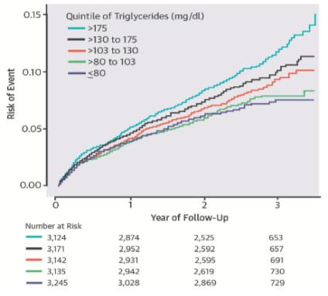
Schwartz, G. G., Abt, M., Bao, W., DeMicco, D., Kallend, D., Miller, M., ... & Olsson, A. G. (2015). Fasting triglycerides predict recurrent ischemic events in patients with acute coronary syndrome treated with statins. Journal of the American College of Cardiology, 65(21), 2267-2275.
Notes:
Algo que me llamo la atencion era que se evidencio mayor esifo en los qintiles 3,4 ,5, y llama la atencion que el 3 tiene rango de 103 - 130 que son nivles categorizados como normlaes
Ya hablamos de los riesgos, de si esto puede ser un predictor y una pregunta que nos queda mportantes es, y que pasa con la mortaldaid
Que nos llamo la atencin que incusi en oacsientes con nivles de TG de 103 – 130 tenian riesgo y estas concentraciones son considerados comos normlaes
n dal-OUTCOMES, long-term risk after ACS was higher in quintiles 3, 4, and 5 of the triglyceride dis- tribution, compared with quintile 1. Because the lower bound of quintile 3 corresponded to a triglyc- eride concentration of just 105 mg/dl, increased risk associated with triglyceride rich lipoproteins was manifest at concentrations that are generally consid- ered to be normal. In this regard, the present findings are consistent with a scientific statement by the American Heart Association that optimal fasting tri- glyceride levels may be <100 mg/dl

Slide 22
Metanálisis
Objetivo: asociación de los niveles de TG y mortalidad cardiovascular, mortalidad por todas las causas.
61 estudios, 17.018 muerte por eventos cardiovasculares, 58.419 muertes por todas las causas.
Seguimiento: 12 años.
Liu, J., Zeng, F. F., Liu, Z. M., Zhang, C. X., Ling, W. H., & Chen, Y. M. (2013). Effects of blood triglycerides on cardiovascular and all-cause mortality: a systematic review and meta-analysis of 61 prospective studies. Lipids in health and disease, 12(1), 159.
Notes:
La relación de los TG y el reisgo de muerte es incietto, este estudio evalua la asociación de los niveles de tg en sangre y la mortaldia vardiovascular y mortalidad por todas las cauas
We identified 61 eligible studies, containing 17,018 CVDs deaths in 726,030 participants and 58,419 all-cause deaths in 330,566 participants.
Metanalisis de donde 33 estudios evaluaban la mortadlida cardiovascular y 38 la mortadliad por todas las cauas.
Duracion del seguimiento de 12 años.
Paciente con DM, CVD o cancer fueron excluidos.
El grupo de 150 – 200 aumenta el riesgo de ECV 15% y mortalidad 9%
200, ECV 25% y mortalidad 20%
Por cada aumento de 88mg/dl de TG el riego de ECV aumenta un 13% y mortalidad 12%

Slide 23
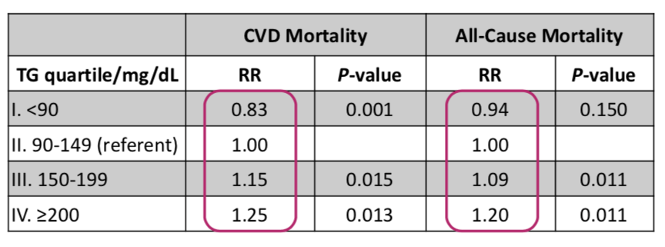
150 – 200mg/dl: aumento riesgo de mortalidad cardiovascular (15%) y mortalidad por todas las causas (9%).
200mg/dl: riesgo mortalidad cardiovascular (25%) y mortalidad por todas las causas (20%)
Por cada aumento de 88mg/dl de TG el riesgo de mortalidad cardiovascular aumenta un 13% y mortalidad un12%.
Notes:
Compared to the referent, the risks of CVDs and all-cause mortality were increased by 15.0% and 9.0% in the borderline hypertriglyceridemia group, and 25% and 20% in the hypertriglyceridemia group, respectively. Overall, the risks of CVDs and all-cause death were increased by 13% and 12% per 1-mmol/L increase in TG level.

Slide 24
Limitaciones
Heterogenicidad en los estudios: género, colesterol total y duración de seguimiento.
RR más alto: hombres, mayor duración y ajustados para colesterol total.
28 estudios incluyeron pacientes con eventos cardiovasculares previos.
Aumento de los TG tambien presentaba bajo HDL u aumento colesterol total.
Liu, J., Zeng, F. F., Liu, Z. M., Zhang, C. X., Ling, W. H., & Chen, Y. M. (2013). Effects of blood triglycerides on cardiovascular and all-cause mortality: a systematic review and meta-analysis of 61 prospective studies. Lipids in health and disease, 12(1), 159.
Notes:
First, there was considerable heterogeneity among the studies included with analysis showing that the major sources of heterogen- eity to be gender, adjustment for TC, and follow-up dur- ation. Second, 28 studies that included participants with a prior history of CVDs at baseline were not excluded
Third, elevated TG levels were accompanied by low HDL-c and high TC, both of which have been associated with a higher CVDs ris
higher in men than in women and higher in studies with longer follow-up durations for the risk of both CVDs and total mortality; and tended to be higher for CVDs mortality in the studies that adjusted for TC

Slide 25
Disminución del HDL
Remanentes de lipoproteínas ricas en TG
Resistencia a la insulina
Estados protrombóticos
Aumento de la inflamación
Laufs, U., Parhofer, K. G., Ginsberg, H. N., & Hegele, R. A. (2020). Clinical review on triglycerides. European Heart Journal, 41(1), 99-109c.
Notes:
Hay algunas condiciones que junto con los tg aumentan el riesgo cardiovascular
HTG se asocia a anormliades que preisponen a la ateroesclerosis o al aumento del riesfo cardiovascular

Slide 26
RIESGO DE PANCREATITIS
Tercera causa de pancreatitis aguda.
4 – 10% de los casos.
Embarazadas: primera causa.
Mecanismo no completamente claro.
Cambios en microambiente.
Cambios en el PH.
Adiamah, A., Psaltis, E., Crook, M., & Lobo, D. N. (2018). A systematic review of the epidemiology, pathophysiology and current management of hyperlipidaemic pancreatitis. Clinical nutrition, 37(6), 1810-1822.
Notes:
Otras de las condiciones a las que esta asociadaa la hipertrigliceridemia es el riesgo de pancratitis

Slide 27
Estudio prospectivo de la población de estudio de Copenhagen.
Seguimiento: 6.7 años.
Objetivo: evaluar la hipótesis que la HTG leve y moderada está asociada con pancreatitis aguda.
Desenlace primario: HR de pancreatitis aguda y IM.
Pedersen, S. B., Langsted, A., & Nordestgaard, B. G. (2016). Nonfasting mild-to-moderate hypertriglyceridemia and risk of acute pancreatitis. JAMA internal medicine, 176(12), 1834-1842.
Notes:
Por muchos años sepense que solo la hipertrioglocridemia grave era asociada a pancreatitis pero nuevos estudios han mostrado que tambien esat asocaida a concentraciones moderadas.
While for many years it was . thought that only severe HTG is associated with acute pancreatitis, . newer data indicate that pancreatitis risk increases at moderately ele- . vated TG concentrations in a dose-dependent manner.27

Slide 28
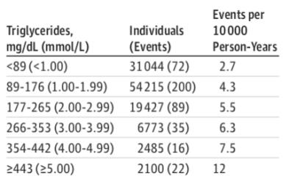
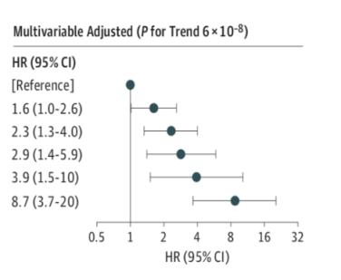
Pedersen, S. B., Langsted, A., & Nordestgaard, B. G. (2016). Nonfasting mild-to-moderate hypertriglyceridemia and risk of acute pancreatitis. JAMA internal medicine, 176(12), 1834-1842.
Notes:
Se encontro que pacientes con concentraciones de Tgtan bajas entre 89 – 176 tenian un HR de 1.6 comaorado con los pcaientes que tenian TG<89
Paceintes con Tg entre 177 – 265, un HR de 2.3
Compared with individuals with plasma triglyceride levels less than 89 mg/dL (<1 mmol/L), the multivariable adjusted HRs for acute pancreatitis were 1.6 (95% CI, 1.0-2.6; 4.3 events/10 000 person-years) for individuals with triglyceride levels of 89 mg/dL to 176 mg/dL (1.00 mmol/L-1.99 mmol/L), 2.3 (95% CI, 1.3-4.0; 5.5 events/10 000 person-years) for 177 mg/dL to 265 mg/dL (2.00 mmol/L-2.99 mmol/L), 2.9 (95% CI, 1.4-5.9; 6.3 events/10 000 person-years) for 366 mg/dL to 353 mg/dL (3.00 mmol/L-3.99 mmol/L), 3.9 (95% CI, 1.5-10.0; 7.5 events/10 000 person-years) for 354 mg/dL-442 mg/dL
(4.00 mmol/L-4.99 mmol/L), and 8.7 (95% CI, 3.7-20.0; 12 events/10 000 person-years) for individuals with triglyceride levels greater than or equal to 443 mg/dL (􏰆5.00 mmol/L)
We found that mild-to-moderate hypertriglyceridemia of 177 mg/ dL (2 mmol/L) and above was associated with high risk of acute pancreatitis in the general population. Hazard ratios for acute pancreatitis were even higher than for myocardial infarction, the latter in accordance with previous findings.16
HAY QUE DECIR
risk is elevated [hazard ratio (HR) 2.4] at TG levels between 2.0 and . 3.0 mmol/L (177–265 mg/dL) but is st

Slide 29
La mayoría de TG> 885mg /dl: no presentaran pancreatitis.
TG 885 – 1779mg/dl: 3% .
TG > 1770mg/dl: 15%.
Síndrome de quilocrominemia.
Pedersen, S. B., Langsted, A., & Nordestgaard, B. G. (2016). Nonfasting mild-to-moderate hypertriglyceridemia and risk of acute pancreatitis. JAMA internal medicine, 176(12), 1834-1842.
Notes:
Cuanado tenemos paceintes con pancreatitis y HT altos podemos pensar en una sindorme de quiocrominemia
e majority of sub- . jects with TG >10 mmol/L (885 mg/dL) will never experience pan- . creatitis. Cohort studies indicate that acute pancreatitis may occur in . 3% of those with TG concentrations between 10 and 20mmol/L . (885–1770 mg/dL) and 15% of those with levels >20 mmol/L . (1770 mg/dL),
However, pan- . creatitis risk is highest in rare patients with monogenic chylomicro- . naemia, in which chylomicrons are indeed the predominant species, . with low to undetectable levels of remnants and downstream lipo- . proteins due to severely impaired lipolytic machinery.6,14,29,30
Bibliografia: articulo de jama 2020

Slide 30
Síndrome de quilocrominemia
TG> 1500mg/dl.
Dolor abdominal, pancreatitis, xantomas, arco coneal.
3 condiciones.
Quilocrominemia multifactorial: déficit LPL.
Quilocrominemia familiar.
Lipodistrofia familiar parcial.
Chait A, Eckel RH. The chylomicronemia syndrome is most often multifactorial.
Notes:
The chylomicronemia syndrome occurs when triglyceride levels are severely elevated (usually >16.95 mmol/L [1500 mg/dL]) and is characterized by such clinical features as abdominal pain, acute pancreatitis, eruptive xanthomas, and lipemia retinalis. It may result from 1 of 3 conditions: the presence of secondary forms of hypertriglyceridemia concurrent with genetic causes of hypertriglyceridemia, termed multifactorial chylomicronemia syndrome (MFCS); a deficiency in the enzyme lipoprotein lipase and some associated proteins, termed familial chylomicronemia syndrome (FCS); or familial partial lipodystrophy. Most chylomicronemia syndrome cases are the result of MFCS; FCS is very rare. In all these conditions, triglyceride-rich lipoproteins accumulate because of impaired plasma clearance.

Slide 31
DIAGNÓSTICO
Clasificación | Valores
Normal | < 150 mg/dl
HTG moderada | 150 – 885mg/dl
HTG grave | > 885 mg/dl
TG ayunas > 150mg/dl.
TG no en ayunas > 175mg/dl.
Laufs, U., Parhofer, K. G., Ginsberg, H. N., & Hegele, R. A. (2020). Clinical review on triglycerides. European Heart Journal, 41(1), 99-109c.
Notes:
Cardiovascular risk begins to increase significantly above a plasma TG level of 150 mg/dL (1.7 mmol/L).
or all patients who are found to have an elevated TG level, an attempt should be made to identify a cause or association (see 'Etiology' above). In patients where a likely cause is not evident, we obtain a serum blood glucose or hemoglobin A1c, creatinine and thyroid-stimulating hormone (TSH), and a urinalysis (ie, albumin/protein). Although a TSH is an important screening test for acquired causes of hypercholesterolemia
DIAGNOSTICO.
Sociedad de endocrinolgia.
focus attention on the very high triglyceride levels that are a risk factor for pancreatitis, we have modified the NCEP ATP III triglyceride classification to include an additional classification of very severe hypertriglyc- eridemia, i.e. levels above 2000 mg/dl (Table 1).
Of subjects with hypertriglyceridemia, about 14% had mild hypertriglyceridemia (150–200 mg/dl), whereas 16% had triglyceride levels of 200–500 mg/dl, and about 2% had levels above 500 mg/dl.
diagnosis of hypertriglyceridemia be based on fasting levels, that mild and moderate hypertriglyceridemia (triglycerides of 150–999 mg/dl) be diagnosed to aid in the evaluation of cardiovascular risk, and that severe and very severe hyper- triglyceridemia (triglycerides of 􏰀 1000 mg/dl) be considered a risk for pancreatitis. The Task Force also recommends that patients with hypertriglyceridemia be evaluated for secondary causes of hyperlipidemia and that subjects with primary hypertriglyceridemia be evaluated for family history of dyslipidemia and cardiovascular disease.

Slide 32
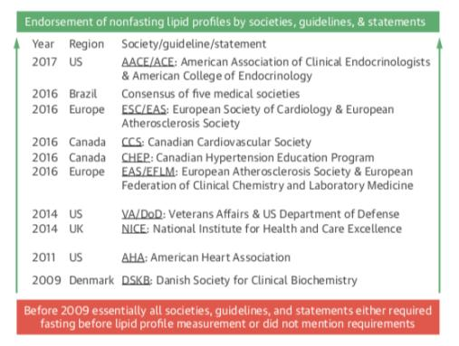
¿EN AYUNAS?
Laufs, U., Parhofer, K. G., Ginsberg, H. N., & Hegele, R. A. (2020). Clinical review on triglycerides. European Heart Journal, 41(1), 99-109c.
Notes:
Tradicionalmente se ha dicho que los lípidos se deb tomar en muestra en ayunas, sin emabrgo hay varios sociedades que apoyan desde el 2009 la recolecion de la muestra no en ayunas.
Como ya vimos no camba en pedecir el riesgo cardiovascular
Es mas practico, amas seguro, ahorra costos, se puede hacer ne la misma visita, ahorra tiempo. Es mas amigable para el medico.
Traditionally, blood sampling for lipid analyses has been recom- . mended in the fasting state.
Desde el 2009
Invstigators of the Multiple Risk Factor Intervention Trial (MRFIT) concluded that average fasting [187 mg/dl (2.11 mmol/liter)] and nonfasting [284 mg/dl (3.21 mmol/ liter)] triglyceride levels were similarly predictive for non- fatal or fatal coronary heart disease with hazard ratios of 1.64 and 1.46, respectively
Es mas practico, amas seguro, ahorra costos, se puede hacer ne la misma visita, ahorra tiempo. Es mas amigable para el medico.
+++++++++++++++++++++++++++++++++++++++++++++++
The Copenhagen City Heart Study (15) comprised 7587 women and 6394 men, aged 20 to 93 yr, recruited from the general population and followed for a mean of 26 yr. After adjustment for other cardiovascular risk factors (age, total cholesterol, body mass index, hyper- tension, diabetes, smoking, alcohol consumption, physical inactivity, lipid-lowering therapy, postmenopausal status, and hormone replacement therapy in women), hazard ratios for quintiles of nonfasting triglyceride levels vs. the reference level of less than 89 mg/dl (􏰁1.0 mmol/liter) were as follows: between 1.7 and 5.4 for women and 1.4 to 2.4 for men for myocardial infarction; between 1.2 and 2.6 for women and 1.1 to 1.5 for men for ischemic heart disease; and between 1.3 and 3.3 for women and 1.2 to 1.8 for men for total death. All results were significant for trend with increasing triglyceride level. Limitations of this analysis include a small number of subjects with high triglycerides, no ad- justment for HDL cholesterol, and a lack of fasting tri- glyceride levels for comparison.
The Women’s Health Study (16) followed 26,509 ini- tially healthy U.S. women older than 45 yr of age for a median of 11.4 yr; testing was done in 20,118 fasting and 6,391 nonfasting participants. The overall rate of cardio- vascular events was 3.46/1000 person-years of follow-up. Although fasting triglyceride levels predicted cardiovas- cular events, the authors did not find an independent as- sociation with cardiovascular events after adjusting for potential confounders. In contrast, higher nonfasting tri- glyceride levels were independently associated with an in- creased risk of future events with hazard ratios for in- creasing tertiles of 1.0 (reference group, 􏰁104 mg/dl), 1.44 [95% confidence interval (CI), 0.90 –2.29; 105–170
Downloaded from https://academic.oup.com/jcem/article-abstract/97/9/2969/2536709 by Universidad de Antioquia user on 16 January 2020
J Clin Endocrinol Metab, September 2012, 97(9):2969–2989
jcem.endojournals.org 2973
mg/dl], and 1.98 (95% CI, 1.21–3.25; 􏰀171 mg/dl) (P 􏰂 0.006 for trend). Associations were strongest among in- dividuals who had their blood drawn 2 to 4 h after a meal and weakened with increasing time after the participants’ last meal. Triglyceride levels and event rates were lower among the healthy U.S. women than those reported in the Copenhagen City Heart Study (15).

Slide 33
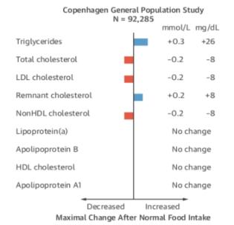
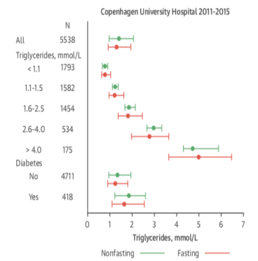
Laufs, U., Parhofer, K. G., Ginsberg, H. N., & Hegele, R. A. (2020). Clinical review on triglycerides. European Heart Journal, 41(1), 99-109c.
Notes:
En el estduio de copehnage nos mostraron que la diferencia que podemos esperar es hasta de 26 mg/dl y que realemnte el perdfil no cambia mucho
. non-fasting samples display a higher TG level of 􏰍0.3 mmol/L (27 mg/ . dL).100,101
On average, and for most individuals, this increment will be . of no clinical significance. Indeed, a number of guidelines recommend . non-fasting sampling.100,102,103
for general risk screening, non-fasting samples seem to have at . least the same prognostic value as fasting samples.104
+++++++++++++++++++++++++++++++++++++
El cambio se puede esperar en una maxmia medida es de 26 mg/dl
The fluctuation in plasma triglycerides is similar in the fasting and nonfasting states, even in those with the highest triglycerides or with diabetes
Also, under nonstandardized, random, nonfasting conditions, plasma triglycerides on average only increase by 26 mg/dl (0.3 mmol/l) at 4 h after a habitual meal (Figures 5 and 6). Such minor changes are clinically unimportant, because a clini- cian is only interested in whether plasma tri- glycerides are 176 mg/dl (2 mmol/l) versus say 440 mg/dl (5 mmol/l), whereas a difference between 176 mg/dl (2 mmol/l) and 202 mg/dl (2.3 mmol/l) is clinically insignificant.
The fluctuation in plasma triglycerides is similar in the fasting and nonfasting states, even in those with the highest triglycerides or with diabetes
Cada vez hay mas evidencia de no en ayunas, tienen mas implicaciones cardiovasculares.
Es mas practico, amas seguro, ahorra costos, se puede hacer ne la misma visita, ahorra tiempo. Es mas amigable para el medico.
El cambio se puede esperar en una maxmia medida es de 26 mg/dl

Slide 34
EN AYUNAS
Triglicéridos > 440mg/dl.
Seguimiento de hipertrigliceridemia.
Luego de pancreatitis.
Al iniciar medicamentos que causan hipertrigliceridemia grave.
Al tomar muestras que requieran ayuno.
Laufs, U., Parhofer, K. G., Ginsberg, H. N., & Hegele, R. A. (2020). Clinical review on triglycerides. European Heart Journal, 41(1), 99-109c.
Notes:
En prueba sin ayunas con tG> 440 repetir en ayunas

Slide 35
¿CÓMO TRATARLOS?

Slide 36
CAMBIOS EN EL ESTILO DE VIDA
Laufs, U., Parhofer, K. G., Ginsberg, H. N., & Hegele, R. A. (2020). Clinical review on triglycerides. European Heart Journal, 41(1), 99-109c.
Notes:
El primer paso debe ser evitar el alcohol en cualqueir cuantidad.
Perdiad de peso tiene un impactico de Reducción de 5 – 10%
Disminución TG: 25%
Ejercicio
30 – 60 min
Aerobico intermitente o reistencia leve
Disminución TG: 20%
DIETA mediterránea rica
Baja en carbohidratos
Acidos grasos polinsaturados
Disminución TG: 10-15%
The first practical step of lifestyle modification relates to alcohol . consumption, which should be avoided in any form and quantity by . individuals with high TG. Also, because of many additional beneficial . metabolic and health effects, an increase of physical activity is another . cornerstone of lifestyle recommendations. With regard to diet, the . most important principle is to reduce net caloric intake. With regard . to specific dietary recommendations, refined carbohydrate-rich . foods as well as sucrose and fructose increase TG much more com- . pared to fibre-rich, low glycaemic index foods.41 As much as possible, . saturated fat should be replaced by mono- or polyunsaturated fats . that improve insulin sensitivity.

Slide 37
OBJETIVOS EN EL TRATAMIENTO
Niveles de TG | Objetivo de tratamiento
HTG moderada (200 – 885). | Prevención de eventos cardiovasculares.
HTG grave > 885mg/dl. | Prevención de pancreatitis.
Laufs, U., Parhofer, K. G., Ginsberg, H. N., & Hegele, R. A. (2020). Clinical review on triglycerides. European Heart Journal, 41(1), 99-109c.
Notes:
Clinically, there are two distinct aspects to TG reduction: (i) modi- . fying lipid levels to decrease ASCVD risk; and (ii) reducing TG to de- . crease the risk for acute pancreatitis.
Although LDL-lowering drugs ave only moderate effects on TG levels, they reduce ASCVD risk in . patients with and without HTG
. We recommend lifestyle therapy, including dietary counseling to achieve appropriate diet composition, phys- ical activity, and a program to achieve weight reduction in overweight and obese individuals as the initial treatment of mild-to-moderate hypertriglyceridemia (1/QQEE).
3.2. For severe and very severe hypertriglyceridemia (􏰀1000 mg/dl), we recommend combining reduction of dietary fat and simple carbohydrate intake with drug treatment to reduce the risk of pancreatitis
We recommend that the treatment goal for patients with moderate hypertriglyceridemia be a non-high-den- sity lipoprotein (HDL) cholesterol level in agreement with NCEP ATP guidelines
We recommend that a fibrate be used as a first-line agent for reduction of triglycerides in patients at risk for triglyceride-induced pancreatitis
e suggest that three drug classes (fibrates, niacin, n-3 fatty acids) alone or in combination with statins be considered as treatment options in patients with moderate to severe triglyceride levels (
We recommend that statins not be used as mono- therapy for severe or very severe hypertriglyceridemia. However, statins may be useful for the treatment of mod- erate hypertriglyceridemia when indicated to modify car- diovascular risk

Slide 38
MEDIDAS NO FARMACOLÓGICAS
Pérdida de peso
Mejora la sensibilidad a la insulina.
Reducción de 5 – 10%.
Disminución TG: 25%.
Ejercicio
30 – 60 min.
Aeróbico intermitente o resistencia leve.
Disminución TG: 20%.
Dieta
Mediterránea.
Baja en carbohidratos.
Ácidos grasos polinsaturados.
Disminución TG: 10-15%.
Notes:
DISMINUCION DE PESO:
Weight reduction improves insulin sensitivity and decreases TG lev- . els. Regular physical exercise reduces plasma TG levels over and . above the effect of weight reduction.
REDUCCION: 5 – 10% DE EPSO – DISMINUCION DEL 25% de lso TG
++++++++++++
DIETA
As regards diet quality, in the weight-stable condition, even in overweight or obese people, reduced carbohydrate intake and increased fat in- take lower fasting triglycerides. There is a quantitative linear relation between replacement of dietary carbohy- drate with fat and reduction in serum triglycerides (152).
Saturated, monounsaturated, and n-6 polyunsaturated fatty acids all lower serum triglycerides when they replace carbohydrate, with no clear difference between fatty acid classes in this action. However, diet affects other cardio- vascular risk factors beyond triglycerides, and such effects need to be taken into account.
Thus, there is a large body of evidence clearly indicating that both dietary saturated fat and trans fatty acids increase LDL cholesterol levels. Replacing these atherogenic fatty acids with monounsat- urated or polyunsaturated fat lowers LDL cholesterol; n-6 polyunsaturated fats have a stronger LDL-lowering effect than monounsaturated fats (152)
Nonetheless, it is rec- ommended that reduced intake of sugar-sweetened bever- ages, whether composed mainly of high-fructose corn syrup or sucrose, is an important part of lowering serum triglyc- erides (151).
ome carbohydrate-rich foods such as potatoes, white bread, and rice increase blood glucose more quickly and to a higher concentration than other carbohydrate-rich foods such as apples, legumes, nuts, pasta, and densely- baked whole grain breads.
The OmniHeart study compared the effects of healthful dietary patterns based on the DASH diet that lowered blood pressure and LDL cholesterol. These dietary pat- terns all emphasize fruits, vegetables, and low-fat dairy products; include whole grains, poultry, fish, and nuts; use unsaturated vegetable oils; and contain smaller amounts of red meat, sweets, and sugar-containing beverages than typical diets in the United States (155, 156). Compared with a diet that emphasized carbohydrate, a similar diet that emphasized protein decreased triglyceride levels fur- ther, and this decrease was about twice the effect of a diet that emphasized unsaturated fat (155).
African-Americans have lower serum triglyceride levels than other racial or ethnic groups. The OmniHeart study, in which 50% of the population was African-American, found that diet modification had less effect on triglyceride levels in this ethnic group than in a Caucasian population when matching baseline triglyceride level
+++++++++++++++++++++
It has been reported that exercise the day before inges- tion of a high-fat meal is associated with a marked damp- ening of the postprandial triglyceride increase.
The minimum exercise required to reduce a postprandial triglyceride increase has not been determined, but a period of 30 – 60 min of intermittent aerobic exercise or mild resistance exercise has been shown to be effective in lowering plasma and VLDL trig- lycerides.
Furthermore, in a recent large, community-based study, a combination of aerobic and resistance exercise was associated with lower triglyc- eride levels in men as compared with aerobic exercise alone (161).

Slide 39
ESTATINAS
HTG moderada: modificar riesgo cardiovascular.
No como monoterapia en HTG grave.
Disminución de TG: 10% – 15%.
Dosis dependiente.
Atorvastatina 80mg, Rosuvastatina 40mg : 25 -30%.
Laufs, U., Parhofer, K. G., Ginsberg, H. N., & Hegele, R. A. (2020). Clinical review on triglycerides. European Heart Journal, 41(1), 99-109c.
Notes:
We recommend that statins not be used as mono- therapy for severe or very severe hypertriglyceridemia. However, statins may be useful for the treatment of mod- erate hypertriglyceridemia when indicated to modify car- diovascular risk
statins, have a modest triglyceride-lowering effect, typically about 10 –15%, which is dose-dependent. High doses of statins that have strong efficacy, such as atorva- statin 80 mg or rosuvastatin 40 mg, can lower plasma triglyceride by 25–30%. Statin monotherapy should not be first-line therapy to reduce triglyceride levels in patients with severe or very severe hypertriglyceridemia (􏰀1000 mg/dl). Addition of statins can be considered to reduce cardiovascular risk in patients with mild-to-moderate hy- pertriglyceridemia (􏰀150 mg/dl and 􏰁1000 mg/dl) and elevated non-HDL cholesterol
+++++++++++++++++
rEDCCION DE HASTA 22 – 45 EN tg> 250

Slide 40
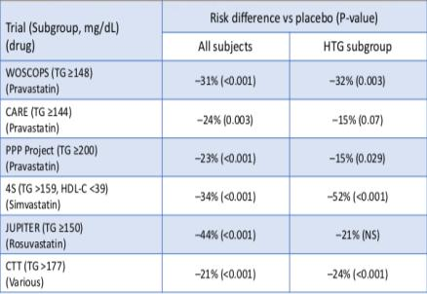
Laufs, U., Parhofer, K. G., Ginsberg, H. N., & Hegele, R. A. (2020). Clinical review on triglycerides. European Heart Journal, 41(1), 99-109c.
Notes:
Estudios que soportan estatinas reduccion de TG

Slide 41
FIBRATOS
Agonista de PPAR.
Aumentan la beta oxidación.
Aumentan la síntesis de LPL.
Disminución TG, VLDL.
Diminución TG 30%-50%.
Disminución LDL < 20% (aumento paradójico).
EA: GI < 5%, rash <2%
Miopatía : gemfibrozil+
Fenofibrate.
Laufs, U., Parhofer, K. G., Ginsberg, H. N., & Hegele, R. A. (2020). Clinical review on triglycerides. European Heart Journal, 41(1), 99-109c.
Notes:
La miopatía se ha visto que tien se presenta 5 veces mas que con las estatinas, sobre todo con el gemfibrzilo.
cUANDO SE une el gemfibrozilo con la estaina, este inhibe el meatbolismo dela estatina y aumenta su concentración. Aumentea el riesgo
Agonistas de los PPAR
Disminucon 50% de TG
20% de LDL
MA: Fibrates are agonists of peroxisome proliferator-activated receptor- . a (PPAR-a),
good efficacy in lowering fasting TG levels, as . well as post-prandial,
: Fibrates increase fatty acid oxidation, increase LpL syn- thesis, and reduce expression of apoC-III, all of which decrease VLDL triglyceride production and increase LpL- mediated catabolism of triglyceride-rich lipoproteins (170).
Effects on lipids . Clinical impacts on lipid profiles vary among members of the fibrate . class, but are estimated to reach a 50% reduction of the TG level, a . <_20% reduction of the LDL-C level (but a paradoxical small LDL-C . increase may be observed
EFECTO cardiovascular:
The clinical effects of fibrates have been primarily illustrated by six RCTs: the Helsinki Heart Study (HHS), Veterans Affairs High Density Lipoprotein Intervention Trial (VA-HIT), Bezafibrate Infarction Prevention (BIP), Lower Extremity Arterial Disease Event Reduction (LEADER), Fenofibrate Intervention and Event Lowering in Diabetes (FIELD), and Action to Control Cardiovascular Risk in Diabetes (ACCORD) trials; in the latter trial, fenofibrate was added to statin therapy.306􏰊311 In CV outcome trials of fibrates, the risk reduction . appeared to be proportional to the degree of non-HDL-C lowering.50
EA: he risk of myopathy has been reported to be 5.5- fold greater with fibrate monotherapy (mainly with gemfibrozil) com- pared with a statin, and it varies with different fibrates and statins used in combination. This is explained by the pharmacological inter- actions between the metabolism of different fibrates and pathways of glucuronidation of statins. Gemfibrozil inhibits the metabolism of sta- tins via the glucuronidation pathway, which leads to marked increases in plasma concentrations of statins.320 As fenofibrate does not share the same pharmacokinetic pathways as gemfibrozil, the risk of myo- pathy is much less with this combination therapy.319
EA:
Side effects include gastrointestinal discomfort and possibly an increased incidence of cholesterol gallstones. Fibrates are contraindicated in patients with liver and gall bladder disease. Fibric acid derivatives should be used with great caution in the setting of renal insufficiency be- cause the drugs are excreted in the urine and may revers- ibly increase serum creatinine levels— especially fenofi- brate, although the significance of this effect is unknown.
Fenofibrate, which does not interfere with statin metab- olism and has a lower risk of causing myopathy, is the preferred fibrate to use in combination with a statin.

Slide 42
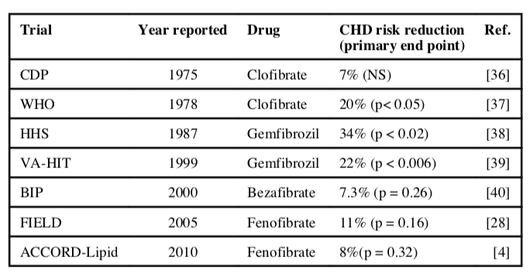
IMPACTO RIESGO CARDIOVASCULAR
Notes:
Cuando nos preguntamos si los fenofibratos tienen un impacto cardiovascular, estos son los estduios de los que e ha hablado y vamos a hablar de alguno de ellos

Slide 43
RCT.
Doble ciego.
Objetivo: valorar eficacia simultánea del gemfibrozilo en aumental HDL → disminuir el no HDL y en disminuir eventos cardiovasculares.
4081 pacientes asintomáticos.
5 años .
Frick, M. H., Elo, O., Haapa, K., Heinonen, O. P., Heinsalmi, P., Helo, P., ... & Mäenpää, H. (1987). Helsinki Heart Study: primary-prevention trial with gemfibrozil in middle-aged men with dyslipidemia. New England Journal of Medicine, 317(20), 1237-1245.
Notes:
RCT
Doble ciego
Valorar la efiacioa somutanea del gemfibrozilo en en aumentar el HDL y dimisnuir el colestrrol no hdl en reduceirlos eventos cardiovasculares en 4081 pacientes asintomáticos.
gENFIBROzilo 600 mg vs placebo por 5 años
Gemfibrozilo 2051
Placebo 2030
EFECTO CARDIOVASCULAR:
HHS:
eL NUMEOR DE EVENTOS cardiacos fue 56 en el grupo de gemfibrozilo comaprado con 84 con el placcebo.
Sin embargo a pesar que hubo una reduccion por causa de muertees cardiobasculares, hubo un aumento enel grupo de gemfibrozlio de muertes totales comparado con el placebo.
++++++++++++++++++++++++++++++++++++++++++++++++++++++++++
lthough the HHS reported a significant reduction in CVD out- comes with gemfibrozil, neither the FIELD nor the ACCORD studies involving fenofibrate showed a reduction in total CVD outcomes.
The LEADER trial included male participants with lower-extremity arterial disease and failed to show that bezafibrate could lead to a clinically important reduction in CVD combined endpoint.
Only one study, ACCORD, has analysed the effect of a fibrate as an add-on treatment to a statin.
Results from other meta-analyses suggest reduced major CVD events in patients with high TGs and low HDL-C in fibrate- treated patients, but no decrease in CVD or total mortality. .314􏰊- 316
Thus, the overall efficacy of fibrates on CVD outcomes is much less robust than that of statins. Recently, a new selective PPAR-a modula- tor (pemafibrate) has been reported to have marked efficacy in reducing TRLs.317 The study, Pemafibrate to Reduce Cardiovascular OutcoMes by Reducing Triglycerides IN PatiENts With DiabeTes (PROMINENT), is an ongoing CVD outcome trial designed to evalu- ate the efficacy of pemafibrate in some 10 0

Slide 44
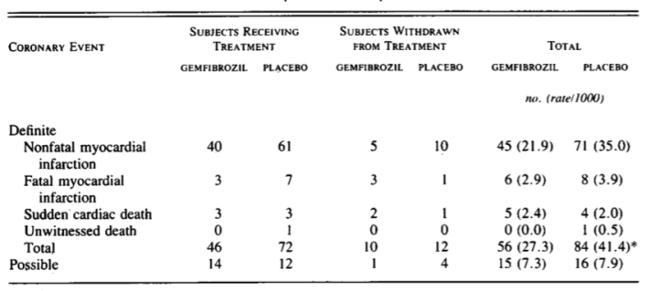
Notes:
Los eventos cardiovasculares acumulados a lso 5 años fue de 27.3 por cada 1000 apceintes en el grupo de genfibrozilo y 41.4 en pacienes el grupo placebo.

Slide 45
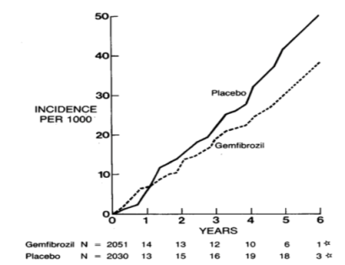
Notes:
Hubo una reduccion del 34% en la incidencia de enfermdad corinarioa ( 8.2 – 52.6) p: 0-02 durante rodo el estudio. Y una una reduccion mayor del 50% entre los aos 3 - 5.

Slide 46
RCT.
Doble ciego.
63: centro de Australia.
Objetivo: efecto a largo plazo del fenofibrato en eventos cardiovasculares en pacientes con DM tipo 2.
9795 pacientes: 50 – 75 años con DM tipo 2 y sin indicacion de tomar estatinas.
5 años.
Colesterol total: 116 – 193mg/dl, colesterol total/ HDL> 4, TG: 88 – 442mg/dl.
Desenlace primario: eventos cardiovasculares → muerte por enfermedad coronaria o IM no faltal.
FIELD Study Investigators. (2005). Effects of long-term fenofibrate therapy on cardiovascular events in 9795 people with type 2 diabetes mellitus (the FIELD study): randomised controlled trial. The Lancet, 366(9500), 1849-1861.
Notes:
Sin embargo hay estudios
RCT
Doble ciego en 63 centro de austrilai
Estudio multicentrico con 9795 pacentes entre las edad de 50 – 75 años con DM tipo 2 y sin ndiccacions de tomar etatinas en el inicio del estudio. Fenofibrate 200mg al dua a 4895 pacientes y placebo 4900
Desenlace primario: eventos cardiovasculares ( muerte por envfermdad coronaria o IM no fatal)
5 AÑOS
FIELD Y ACCORD
, neither the FIELD nor the ACCORD studies involving fenofibrate showed a reduction in total CVD outcomes.

Slide 47
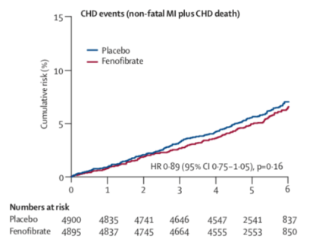
Notes:
Elos encontraron que un 5.2% de paceintes en grupo de l aintervencion comparado con 5.9% de placebo presentaron el desencela primario. Conuna reducccion relativa del 11% sin embargo eto no fue estadisiticaemnte significaitvo
5·9% (n=288) of patients on placebo and 5·2% (n=256) of those on fenofibrate had a coronary event (relative reduction of 11%; hazard ratio [HR] 0·89, 95% CI 0·75–1·05; p=0·16)

Slide 48
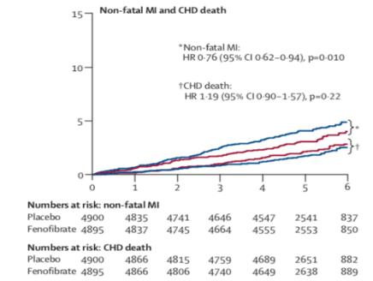
Notes:
Lo que si demostraro fue una disminucion significativa del 24% en IM no falra y no encontraron disminucion significativa en la mortaldiad por enfermedad coronaria
This finding corresponds to a significant 24% reduction in non-fatal myocardial infarction (0·76, 0·62–0·94; p=0·010) and a non-significant increase in coronary heart disease mortality (1·19, 0·90–1·57; p=0·22)

Slide 49
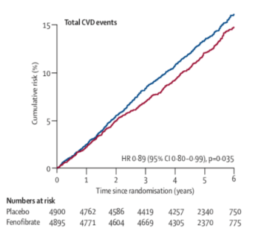
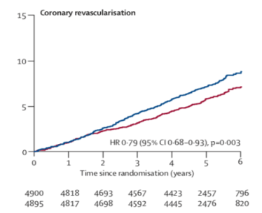
Notes:
Total cardiovascular disease events were significantly reduced from 13·9% to 12.5% (0·89, 0·80–0·99; p=0·035)
This finding included a 21% reduction in coronary revascularisation (0·79, 0·68–0·93; p=0·003).
total cardiovascular events (the composite of cardiovascular death, myocardial infarction, stroke, and coronary and carotid revascularisation)

Slide 50
RCT.
Objetivo: combinación de fibratos y estatinas es más efectivo para prevenir eventos cardiovasculares mayores en pacientes con DM tipo 2 comparado con monoterapia con estatinas.
5518 pacientes.
Fenofibrato + simvastatina; simvastatina + placebo.
4. 7 años.
Desenlace primario: IM fatal y no fatal, ECV fatal y no fatal.
Elam, M., Lovato, L., & Ginsberg, H. (2011). The ACCORD-Lipid study: implications for treatment of dyslipidemia in type 2 diabetes mellitus. Clinical lipidology, 6(1), 9-20.
Notes:
The Action to Control Cardiovascular Risk in Diabetes (ACCORD)-Lipid trial tested the hypothesis that combination therapy with a fibrate and statin would more effectively prevent major CVD events in a high-risk population of patients with T2DM compared with statin monotherapy.
over 5000 patients were treated with fenofibrate plus simvastatin versus simvastatin alone.
77 clinicas en usa y canada
Participants were followed for an average of 4.7 years and the effect of the study intervention on rates of occurrence of the primary CVD end point (fatal and nonfatal coronary heart disease and stroke) was assessed

Slide 51
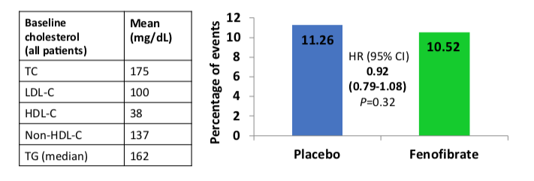
Seguimiento: 4.7 años.
Eventos cardiovasculares mayores: 8% menor en grupo de fenofribrato.
Simvastatina vs placebo P: 0.32 .
Notes:
Deepsus de un seguimeinto de 4.7 años, los eventos cardiovasclares mayores se reujeron en un 8% en el grupo fenofibrrro – simvastatina sin embrgo no tuvo significancia estadistica.
Pero en en un apoblacion especifica
After an average follow-up of 4.7 years, major cardiovascular events (fatal and nonfatal coronary heart disease and stroke) were 8% lower in the fenofibrate–simvastatin group versus the placebo–simvastatin group (p = 0.32).
Sin embargo en un pobalcion especeficia
NO REDUJO RIESGO CARDIOVASCULAR
n the Action to Control Cardiovascular Risk in Diabetes (ACCORD) trial, which was overall negative, a subanalysis showed that in patients with low HDL-C and high triglyceride levels, the addition of a fibrate to a statin treatment may partially, but significantly, address the residual risk while on statin.3,7

Slide 52
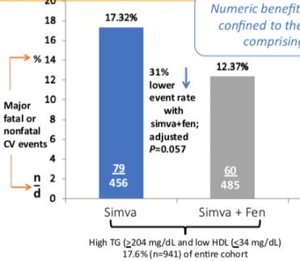
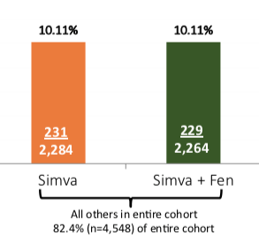
Reducción de eventos cardiovasculares: 31%.
Notes:
Sin embargo e n analisis de subgrupos donde tg > 204 y hdl < 34, hubo una disminucion de eventos cardiovasculares 31%
CVD events were reduced by 31 % with fenofibrate treatment in a prespecified subgroup of ACCORD-Lipid participants whose baseline triglyceride levels were in the upper fertile (>2.30 mmol/l or >204 mg/dl) and HDL-C levels in the lower fertile (<0.88 mmol/l or <34 mg/dl) of the study population

Slide 53
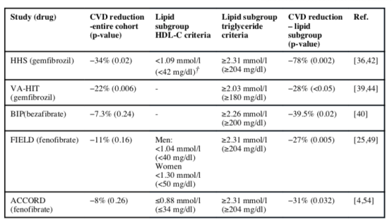
Notes:
En los estudios que antes mencione y en unos mas antiguos se hzo tambien este analisis en este subgrupo de pcinetes con hdl baja y tg amentos y en todos se evidencio un imapcto en la reduccion de los eventos cardiovasculares

Slide 54
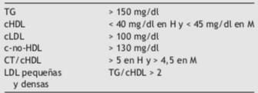
Ascaso, J. F., Millán, J., Hernández-Mijares, A., Blasco, M., Brea, Á., Díaz, Á., ... & Pintó, X. (2017). Documento de consenso sobre el manejo de la dislipemia aterogénica de la Sociedad Española de Arteriosclerosis. Clinica e investigación en Arteriosclerosis, 29(2), 86-91.
Notes:
Este subf¡grupo de pacientes con por la preencia de Tg altos, hdl bajo, LDL levemente aumento y no hDL altos se denomina que tiene una dislipidemia aterogenica .
es consecuencia del aumento del conjunto de las lipoproteínas ricas en TG, incluyendo sus partícu- las remanentes, y por la elevación moderada de las LDL; s decir, el conjunto de las lipoproteínas aterogénicas que contienen apoB.
Este perfil lípidico es la causa que los paciente a pesar de tener metas de LDL siguen haciendo eventos coronarios, lo que determinamos el riesgo residula
++++++++++++++
Este subgrupo de paceintes presenta una dislipidemia aterogenica que se caracteriza por presenta Tg altos , HDL bajos, LDL altos, NO HDL, altos
Disbalance entre lipoporterinas aterogenicas ricas en apo b y ricas en tg y las anti aterogenicas que tienen apo A.
Es mas prevalente en pacientes con DM,sindrome metabolico, obesos, ERC
Causa de riesgo residual: los pacientes siguen haciendo eventos coronarios a pesar de tener metas de LDL
Perfil lipidico de etsso pacientes:
TG altos
HDL baj o
LDL normal o levemente elvados
Colesterol no hDL elevaods

Slide 55
Bruckert, E., Labreuche, J., Deplanque, D., Touboul, P. J., & Amarenco, P. (2011). Fibrates effect on cardiovascular risk is greater in patients with high triglyceride levels or atherogenic dyslipidemia profile: a systematic review and meta-analysis. Journal of cardiovascular pharmacology, 57(2), 267-272.
Notes:
Este metanalissi donde e icluyeron 5 estudios, querin identidicar el efecos de los fibratos en el riesgo cardiovascular en paceintes con perfil de dislipidemia aterogenica.
+++++++++++++++++++
Results from other meta-analyses suggest reduced major CVD events in patients with high TGs and low HDL-C in fibrate- treated patients, but no decrease in CVD or total mortality. .314􏰊- 316
%. We found a significant difference in the magnitude of fibrate effect across dyslipidemia subgroups (P for between-group hetero- geneity = 0.0002). A greater effect size was found in patients with high triglyceride levels or atherogenic dyslipidemia phenotype where fibrates were estimated to reduce the cardiovascular risk by 28% [95% confidence interval (CI), 15% to 39%; P , 0.001] or 30% (95% CI, 19% to 40%, P , 0.0001), respectively, but only by 6% (95% CI, 22% to 13%, P = 0.13) in nonatherogenic dyslipidemia patients.
the present analysis highlights the strong consistency in trials that demonstrated a higher benefit in the subgroup with high triglyceride levels combined with low HDL-C, in such patients who may be considered as having atherogenic dyslipidemia
Targeting patients with high triglyceride levels or atherogenic dys- lipidemia with fibrates may help reduce residual vascular risk.
The present meta-analysis of 5 large randomized controlled trials analyzed the effect of fibrate alone or in combination in patients selected based on their biological characteristics at inclusion. We found a significant reduction in cardiovascular events (28%, 17%, and 30%, respectively, in patients with hypertriglyceridemia alone, low HDL-C levels alone, or a combination of both lipid abnormalities).
n this way, the present analysis highlights the strong consistency in trials that demonstrated a higher benefit in the subgroup with high triglyceride levels combined with low HDL-C, in such patients who may be considered as having atherogenic dyslipidemia.
In contrast, the reduction in events was almost absent in patients with normal serum levels of HDL-C, triglycerides, or both (3%, 6%, and 6%, respectively).
the present analysis highlights the strong consistency in trials that demonstrated a higher benefit in the subgroup with high triglyceride levels combined with low HDL-C, in such patients who may be considered as having atherogenic dyslipidemia.
the present analysis suggested that a therapeutic strategy including fibrate treatment might further decrease cardiovas- cular events in subgroup of patients selected not only based on their cardiovascular risk but also based on their lipid profile
Although the overall effect of fibrate on major cardiovascular events has been recently estimated to be a 10% RR reduction,6
the subgroup analysis of the ACCORD study in patients with high triglyceride and low HDL-C levels also underlined the potential higher effect in atherogenic dyslipidemia patients.7
In this respect it is important to note that we were not able to assess effect on total mortality in the subgroup of patients selected for our meta-analysis.
the subgroup presenting atherogenic dyslipidemia benefited most of fibrate therapy with a 30% decrease in events as ompared with a 17%–18% decrease with isolated high triglycerides or low HDL-C.

Slide 56
Dislipidemia aterogenica : 30% (19% - 40%) p: 0.0001.
Dislipidemia no aterogenica: 6% p: 0.13.
TG aumentados > 200: 28% ( 15 – 39%) p: 0.001.
HDL bajo < 35: 17% (9% - 24%).
Notes:
Diferencia signifcativa en la magnitud del efecto de los fibratos
en la reducción el resgo cardiovascular en los subgrupos de dislipidemias
%. We found a significant difference in the magnitude of fibrate effect across dyslipidemia subgroups (P for between-group hetero- geneity = 0.0002). A greater effect size was found in patients with high triglyceride levels or atherogenic dyslipidemia phenotype where fibrates were estimated to reduce the cardiovascular risk by 28% [95% confidence interval (CI), 15% to 39%; P , 0.001] or 30% (95% CI, 19% to 40%, P , 0.0001), respectively, but only by 6% (95% CI, 22% to 13%, P = 0.13) in nonatherogenic dyslipidemia patients.

Slide 57
Dislipidemia aterogénica: riesgo residual.
Fibratos pueden mejorar este riesgo residual en pacientes con HDL y TG fuera de metas.
Terapia con fibratos: no solo en riesgo cardiovascular, perfil de lípidos.

Slide 58
OMEGA 3
Ácido eicosanoico, ácido docosahexanoico.
2 -4gr/día.
Disminuye TG. Efecto en lipoproteínas es controversial.
Disminución TG: 45%.
Dosis dependiente.
Laufs, U., Parhofer, K. G., Ginsberg, H. N., & Hegele, R. A. (2020). Clinical review on triglycerides. European Heart Journal, 41(1), 99-109c.
Notes:
n-3 fatty acids reduce TGs, but their effects on other lipoproteins are
. trivial. More detailed data on clinical outcomes are needed to justify . 323
. wide use of prescription n-3 fatty acids. The recommended doses . of total EPA and DHA to lower TGs have varied between 2􏰀4 g/day. . Three recent studies in people with high TGs using EPA reported a . significant reduction in serum TG levels of up to 45% in a dose- . dependent manner.324􏰀326 The efficacy of omega-3 fatty acids in low- . ering serum TGs has also been reported in meta-analyses.157 . Recently, the EpanoVa fOr Lowering Very high triglyceridEs II . (EVOLVE II) trial confirmed the efficacy of omega-3 fatty acids in low- . ering serum TGs.327
++++++++++++++
Guia de endocrinologia:
he long-chain marine omega-3 fatty acids [eicosapen- taenoic acid, C20:5n-3 (EPA) and docosahexaenoic acid, C22:6n-3 (DHA)] lower fasting and postprandial triglyc- eride levels in a dose-dependent fashion. Approximately 3 to 4 g/d of EPA plus DHA are necessary to reduce hyper- triglyceridemia by 20–50%
HDL cholesterol is mildly increased by about 5%. With reductions of triglyc- eride levels, there can be increased levels of LDL choles- terol due to increased conversion of VLDL to LDL
To date, no studies using high-dose n-3 fatty acids in hyper- triglyceridemia patients have shown a beneficial cardio- vascular outcome.
Omega-3 fatty acids (e.g. Lovaza) may be considered for treatment of triglyceride levels above 1000 mg/dl. Over-the-counter preparations of omega-3 fatty acids have variable quantities of EPA and DHA rang- ing from 20 –50%, depending on products.
Side effects with large doses of omega-3 fatty acids include fishy taste and burping. Beyond an impact of ome- ga-3 fatty acid supplements on triglyceride levels, intake of diets rich in n-3 fatty acids have resulted in positive out- comes with regard to cardiovascular disease (182–184).

Slide 59
EFECTO CARDIOVASCULAR
REDUCE IT.
RCT.
Doble ciego.
EPA 2 gr cada 12 horas vs placebo.
Pacientes con DM o enfermedad cardiovascular establecida y otro factores de riesgo.
Que estuvieran en terapia con estatinas.
TG 135 – 499mg/dl.
HDL 41 -100mg/dl.
Desenlace primario: MACE.
Compuesto: muerte cardiovascular, IAM no falta, ECV no fatal, revascularización y angina inestable.
Bhatt DL, Steg PG, Miller M, Brinton EA, Jacobson TA, Ketchum SB, Doyle RT . Jr, Juliano RA, Jiao L, Granowitz C, Tardif JC, Ballantyne CM; REDUCE-IT . Investigators. Cardiovascular risk reduction with icosapent ethyl for hypertrigly- . ceridemia. N Engl J Med 2019;380:11􏰀22.
Notes:
double-blind, placebo-controlled trial involving patients with established cardiovascular disease or with diabetes and other risk factors, who had been receiving statin therapy and who had a fasting triglyceride level of 135 to 499 mg per deciliter (1.52 to 5.63 mmol per liter) and a low-density lipoprotein cholesterol level of 41 to 100 mg per deciliter (1.06 to 2.59 mmol per liter). The patients were randomly assigned to receive 2 g of icosapent ethyl twice daily (total daily dose, 4 g) or placebo. The primary endpointwasacompositeofcardiovasculardeath,nonfatalmyocardialinfarction,nonfatal stroke, coronary revascularization, or unstable angin
Primary objective: To assess whether treatment with icosapent ethyl reduces ischemic events in statin-treated patients with high TG at elevated CV risk
primary end-point event occurred in 17.2% of the patients in the icosapent ethyl group, as compared with 22.0% of the patients in the placebo group (hazard ratio, 0.75; 95% confidence interval [CI], 0.68 to 0.83; P<0.001)
The Reduction of . Cardiovascular Events with EPA-Intervention Trial (REDUCE-IT)195 . aimed to evaluate the potential benefits of omega-3 oil (EPA) on SCVD outcomes in people with elevated serum TGs; the trial enrolled 􏰃8000 patients on statin therapy, with LDL-C levels between 1.0􏰀2.6 mmol/L (41􏰀100 mg/dL) and various CV risk fac- tors, including persistent elevated TGs between 1.7􏰀5.6 mmol/L (150􏰀499 mg/dL), and either established ASCVD or DM, and at least one other CV risk factor. Use of high doses (2 g b.i.d.) of EPA as com- pared with placebo (mineral oil) resulted in a 􏰃25% relative risk reduction (P < 0.001) in major adverse CV events (MACE)

Slide 60
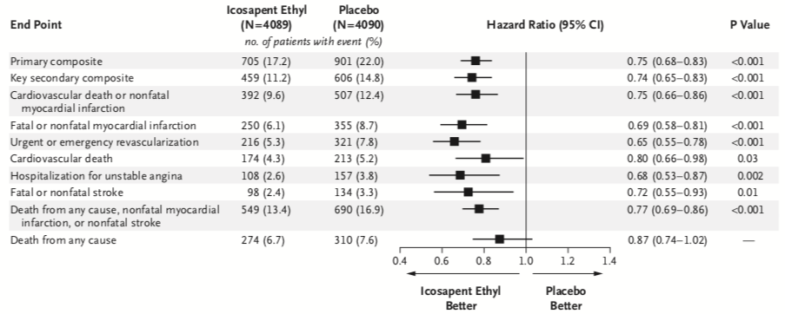
Desenlace primario:
Ácido eicosapentanoico: 17%.
Placebo: 22%.
HR: 0.75 ( 0.68 – 0.83).
Reduccion del riesgo: 25%.
Notes:
EL DESENLACE PRIMARIO ocriio en 17.2% en el grupo de icopent coparado con 22% en el grupo paveco.
Ecnonraron que ene l analisis del tiempo al evento hubo una reduccion del 25% de evtnos en personas con tratamiento con 2gr dos veces al dia.
Numero a tratar de 21.
primary end-point event occurred in 17.2% of the patients in the icosapent ethyl group, as compared with 22.0% of the patients in the placebo group (hazard ratio, 0.75; 95% confidence interval [CI], 0.68 to 0.83; P<0.001)
In REDUCE-IT, the risk of the primary composite end point of cardiovascular death, nonfatal myo- cardial infarction, nonfatal stroke, coronary re- vascularization, or unstable angina, assessed in a time-to-event analysis, was significantly lower, by 25%, among the patients who received 2 g of icosapent ethyl twice daily than among those who received placebo, corresponding to an abso- lute between-group difference of 4.8 percentage points in the rate of the end point and a number needed to treat of 21

Slide 61
Desenlace primario:
Reducción de los eventos cardiovasculares en pacientes en tratamiento con estatinas con HTG y HDL disminuido con riesgo de desarrolar eventos cardiovascualres.
Nicholls, S. J., Lincoff, A. M., Bash, D., Ballantyne, C. M., Barter, P. J., Davidson, M. H., ... & Pedersen, T. R. (2018). Assessment of omega‐3 carboxylic acids in statin‐treated patients with high levels of triglycerides and low levels of high‐density lipoprotein cholesterol: rationale and design of the STRENGTH trial. Clinical cardiology, 41(10), 1281-1288.
Notes:
Este es el estduio streng que evaluara el omega 3 carboxilo en paceintes con perfil de dislipidemia aterogenica y su obejetico es la educcion de eventos cardivasculares.
YA terminaron su reclitamiento y estamos esperando sus reusltados
+++++++++
STRENGTH wiill examine whether Epanova 4 g daily reduces the rate of cardiovascular events in statin‐treated patients with hypertriglyceridemia and low levels of HDL‐C at high risk for developing cardiovascular events.
STRENGTH is a randomized, double‐blind, placebo‐controlled trial. Patients had a triglyceride level ≥ 180 to <500 mg/dL and HDL‐C < 42 mg/dL (men) or < 47 mg/dL (women) in the presence of either (1) established atherosclerotic cardiovascular disease, (2) diabetes with one additional risk factor, or (3) were other high‐risk primary prevention patients, based on age and risk factor assessment. Patients should be treated with a statin, for >4 weeks, and have LDL‐C < 100 mg/dL, but were also eligible if LDL‐C was ≥100 mg/dL while on maximum tolerated statin therapy.

Slide 62
VOLANESORSEN
Inhibe el mRNA de la apo CII
APPROACH trial
Reducción TG < 750mg/dl en 77%
EA: trombocitopenia
No aprobado por la FDA
Laufs, U., Parhofer, K. G., Ginsberg, H. N., & Hegele, R. A. (2020). Clinical review on triglycerides. European Heart Journal, 41(1), 99-109c.
Notes:
Volanesorsen, an apolipoprotein C-III antisense oligonucleotide, has been reported to decrease plasma apolipoprotein C-III, a risk factor for cardiovascular disease, and decrease TG levels.
In the APPROACH trial, 66 patients with familial chylomicronemia syndrome (see 'Etiology' above) were randomly assigned to volanesorsen (300 mg subcutaneously once a week) or placebo. Volanesorsen lowered TG levels below 750 mg/dL in 77 percent of patients at three months, compared with 10 percent of patients taking placebo .
However, adverse side effects of thrombocytopenia and injection-site reactions were common in the treatment group and absent in the placebo group. The development of N-acetyl-galactosamine antisense oligonucleotide conjugates for delivery to the liver appears to eliminate the thrombocytopenic risk [153]. The drug is not approved for use.

Slide 63
EVINACUMAB
Anticuerpo monoclonal contra ANGPTL3
Reducción TG: 75%
Reducción LDL: 23%
Independiente del receptor LDL
Hipercolesterolemia familiar
Laufs, U., Parhofer, K. G., Ginsberg, H. N., & Hegele, R. A. (2020). Clinical review on triglycerides. European Heart Journal, 41(1), 99-109c.
Notes:
ANGPTL3 is a genetically validated target for HTG to reduce . ASCVD risk.11,77–79
The monoclonal antibody evinacumab and ASO . IONIS-ANGPTL3-LRx reduce angiopoietin-like protein 3 . (ANGPTL3), a liver-derived protein that regulates lipid metabolism . through incompletely defined mechanisms. Anti-ANGPTL3 therapies . reduce both severely elevated TG and severely elevated LDL-C (fa- . milial hypercholesterolaemia). In dose-finding studies, evinacumab . reduced both TG and LDL-C by up to 75% and 23%, respectively; . the latter effect appears to be independent of the LDL receptor path- . way.80 Among homozygous familial hypercholesterolaemia patients, . evinacumab reduced LDL-C, TG and HDL-C by 49%, 47%, and 36%, . respectively.81

Slide 64
¿A QUIÉN?

Slide 65
RECOMENDACIONES
Mach, F., Baigent, C., Catapano, A. L., Koskinas, K. C., Casula, M., Badimon, L., ... & Graham, I. M. (2020). 2019 ESC/EAS Guidelines for the management of dyslipidaemias: lipid modification to reduce cardiovascular risk: The Task Force for the management of dyslipidaemias of the European Society of Cardiology (ESC) and European Atherosclerosis Society (EAS). European heart journal, 41(1), 111-188.
Notes:
Estatinas com primera linea para disminuir el riesgo caridovascular en paceinte con TG > 200
Alto riesgo con TG 135 – 499, a pesar del tto con estatinas, acido icosapentico 4gr al dia se puede considerar
En prevencion primaria, pacientes con metas de LDL con TG > 200mg/dl. Fenofibrato se puede considerar en combinacion con estatinas
En alto riesgo LDL en metas pero TG > 200, fnofibrato se considera en combinacion con esttinas

Slide 66
Estatinas como primera línea para disminuir el RCV con TG> 200mg/dl. IB
Alto riesgo con TG 135 – 499 a pesar del tratamiento con estatinas: considerar combinación EPA 4gr/dia + estatina. IIbC.
Prevención primaria, LDL en metas + TG> 200mg/dl: considerar combinación fenofibrato + estatinas. IIaB.
Alto riesgo, LDL en metas + TG > 200mg/dl: considerar fenofibrato + estatinas. IIbB.
Notes:
Estatinas com primera linea para disminuir el riesgo caridovascular en paceinte con TG > 200
Alto riesgo con TG 135 – 499, a pesar del tto con estatinas, acido icosapentico 4gr al dia se puede considerar
En prevencion primaria, pacientes con metas de LDL con TG > 200mg/dl. Fenofibrato se puede considerar en combinacion con estatinas
En alto riesgo LDL en metas pero TG > 200, fnofibrato se considera en combinacion con esttinas

Slide 67
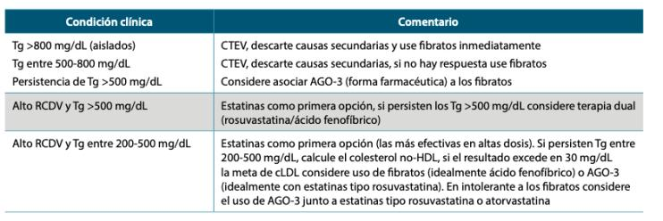
Recomendaciones del panel de expertos sobre la fisiopatología, diagnóstico y tratamiendo de la dislipidemia en la población adulta, ACE,SCC:2020
Notes:
La scoeiad de endocrinologia nos trae estas recomendaciones de xperotos

Slide 68
150mg/dl – 885 mg/dl
Tratamiento solo si hay alto riesgo cardiovascular.
Estatinas si está indicado.
>885mg/dl
Prevención de pancreatitis.
Iniciar terapia TG 500mg/dl si ya tuvo episodio previo.
EPA 4gr/día.
Iniciar con fenofibrato.
Metas < 500mg/dl.
Notes:
Pacientes 150 – 885: solo se recomienda tratamiento en pacentes con alto riesgo cardiovascular.
dEBEN tener estatinas si esta indicaco
Se recomienda el EPA 4 gr ( estudio REDUC IT )
885: prevencion de pacnratitis
Se pude considerar inicar terapia sen niveles de 500 o menor si ya tuvo un episidoo previo
Se icniiar con fenofibrato
sE BUSCAN metas < 500
Pancratitis recurrente con fibrato y hiertriglceridemia ersiten: se buscan una reduccion estrica de carbohydratos, acohl cero, restrccion calorica,para tener epso ideal, se le aidicopna omega 3

Slide 69
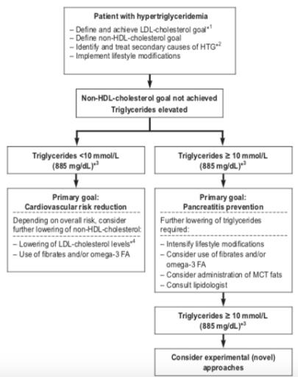

Slide 70
MUCHAS GRACIAS
Notes:
Hay muchos estudios con fibratos que resaldar el imapcto el riesgo cardiovascular y otro no, se eseprar el nuevo estudio de pemfibrato
NO queda duda que en los paceintes con aterogenica con riesgo residaul si hay un impacto
Todavia no es claro el beneficio de fibratos en disminucion del reisgo cardiovacular
Si es el la dislipidmeia aterogenica con riesgo residucal
Pancreatitis tambein hay riesgo en htg moderada

